Slide 1
Introducing Deep Learning & PyTorch Library
Chapter # 1

Slide 2
This Chapter Covers
How deep learning changes our approach to machine learning
Understanding why PyTorch is a good fit for deep learning
Examining a typical deep learning project
The hardware you’ll need to follow along with the examples

Slide 3



Slide 4
Poor Artificial Intelligence
Set of disciplines
Machines are learning to think the way humans do
https://talktotransformer.com, a language model (GPT-2)
Generate coherent paragraphs
Ability to perform these formerly human-only tasks
Acquired through examples
Rather than encoded by a human
Notes:
{
Generative Pre-trained Transformer 2 is an open-source artificial intelligence created by OpenAI
}
Poor artificial Intelligence, ok so why is artificial intel poor. Is ki sab sy bare waja to ye hai k hum main sy akar ko ye e ni pata hota k ai hai kya. Hum ny bus movies dekh lain k aik robot hai wo sare kaam kr ra hai insan k aur banda chill mast mahol te meethe chol, hai g kyn aise e hai na?
In simple words we think it’s a very fancy domain where everything is possible. Aise e hain nan kyn k jo kam insan 2 din mian ni kr sakta wo machine 2 min main kr k side py ho jate hai acting like a savior,
And the second thing is k Ai k baare main soch k sab sy pehle to yei soch ate hai k machine insan ki tara sochte hai aur us k kaam krte hai.

Slide 5


Slide 6
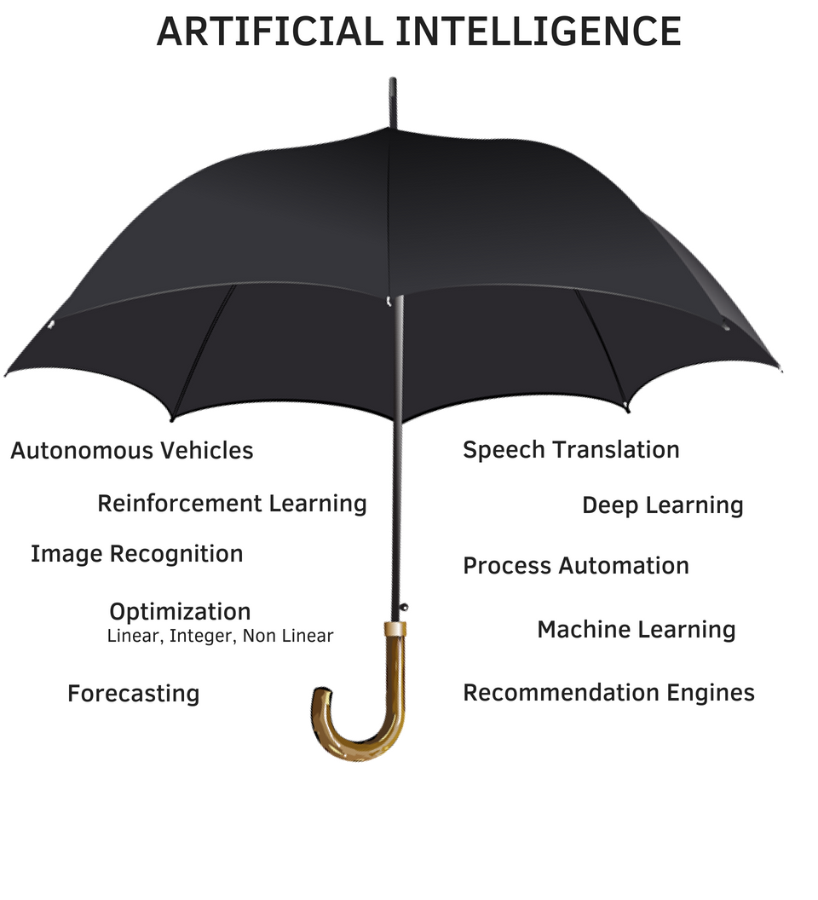

Slide 7
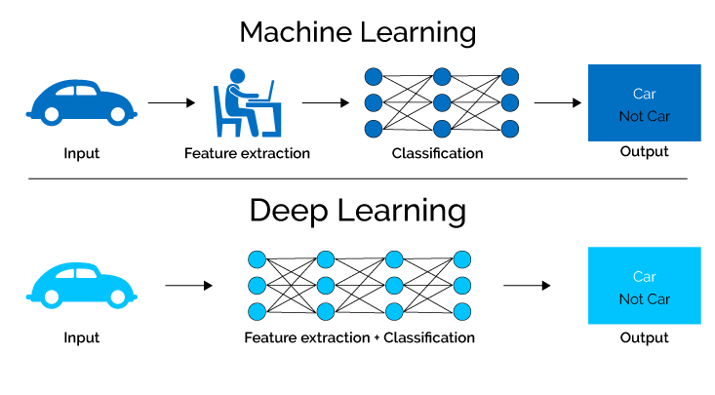

Slide 8
Machine Learning
Relied heavily on Feature Engineering
Transformations on input data
Facilitate a downstream algorithm
Coming up with the right transformations so that the downstream algorithm can solve a task.
Deep learning finds those representations automatically
Feature Engineering has no place with deep learning?
Focus of deep learning practitioners
Not on handcrafting those representations
Operating mathematical entities
Notes:
Downstream is everything after a certain neuron. You say neuron y is downstream of neuron x if and only if there is a directed path from x to y.

Slide 9
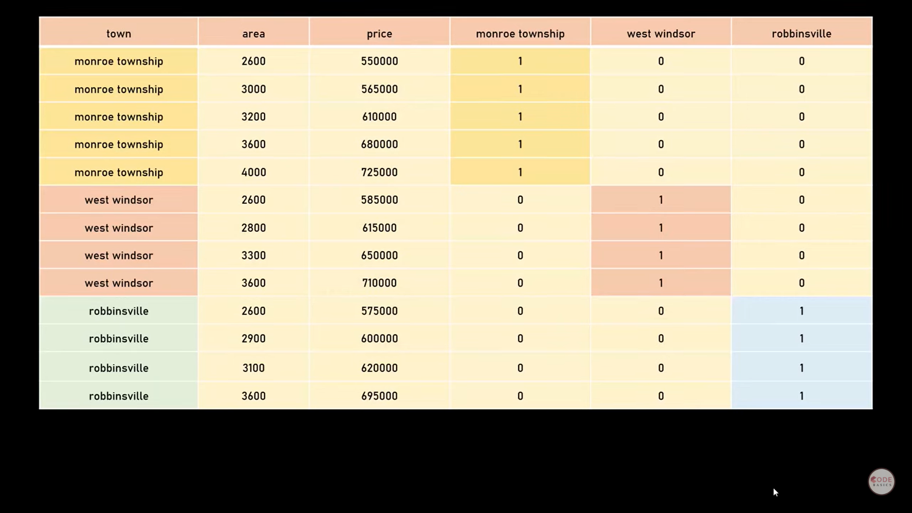

Slide 10
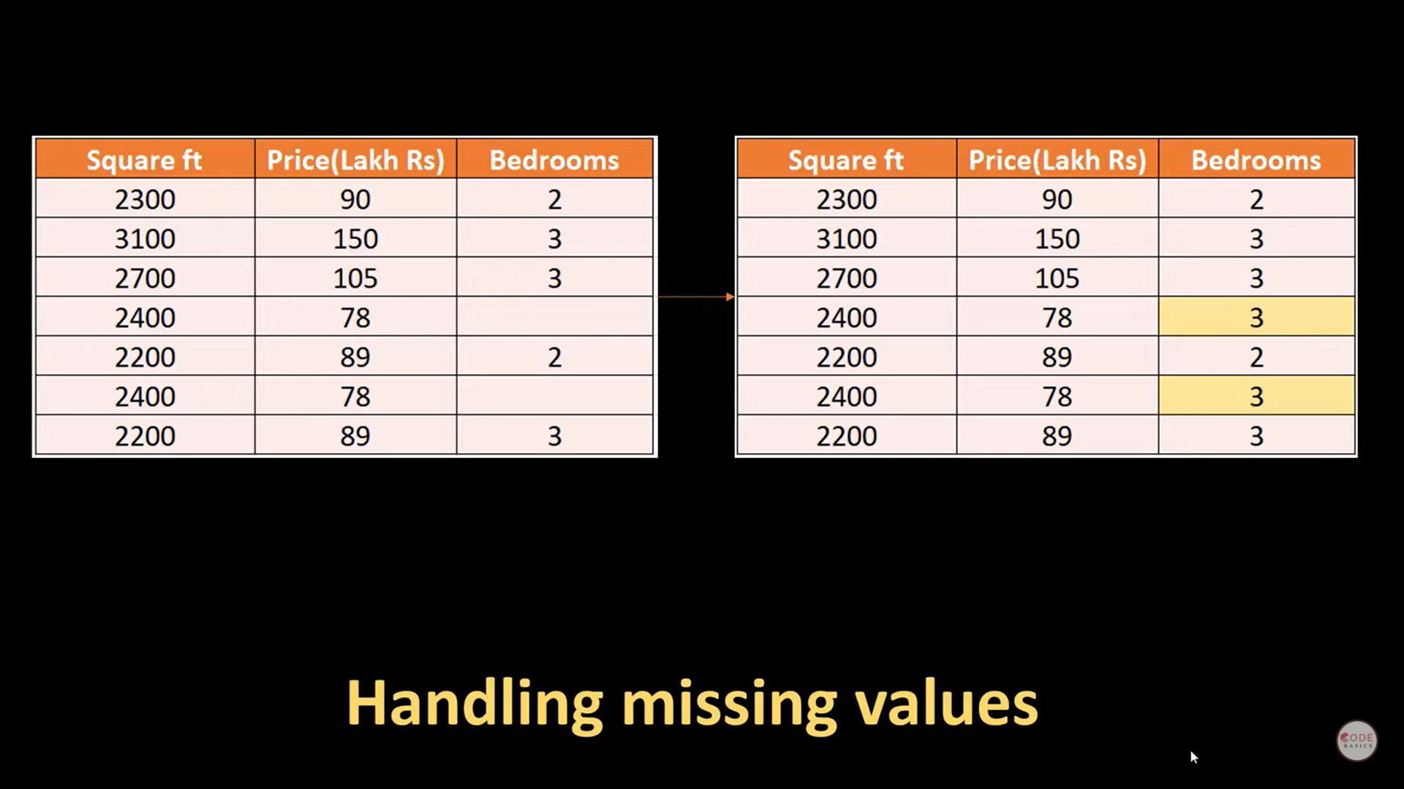

Slide 11
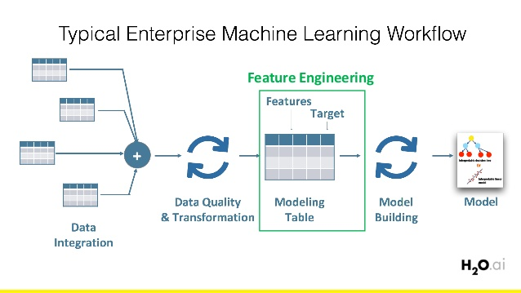

Slide 12
Deep Learning
Class of Algorithms
Falls Under AI subdomain
Trains mathematical entities(Deep nn) by presenting instructive examples
Large amounts of data
Approximate complex functions
Inputs and outputs are far apart
Input image
Output, a line of text describing the input
Notes:
For most "average" problems, you should have 10,000 - 100,000 examples. For “hard” problems like machine translation, high dimensional data generation, or anything requiring deep learning, you should try to get 100,000 - 1,000,000 examples. Generally, the more dimensions your data has, the more data you need.

Slide 13
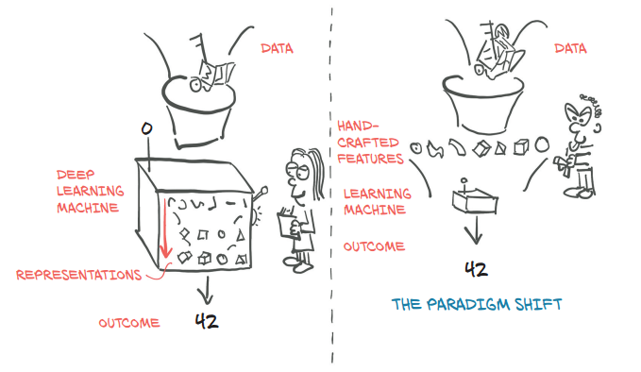
Deep Learning V/S Machine Learning
Notes:
Tabdili ander sy ate hai

Slide 14
Deep Learning
Way to ingest whatever data
Define the deep learning machine
Automated way, training, to obtain useful representations
Machine produce desired outputs
Training
Driving the criterion toward lower
Incrementally modifying our deep learning machine
Until it achieves low scores
On data not seen during training
Notes:
Training consists of driving the criterion toward lower and lower scores by incrementally modifying our deep learning machine until it achieves low scores, even on data not seen during training.

Slide 15
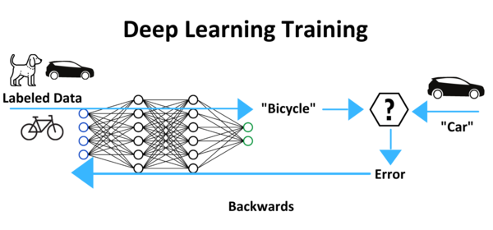

Slide 16
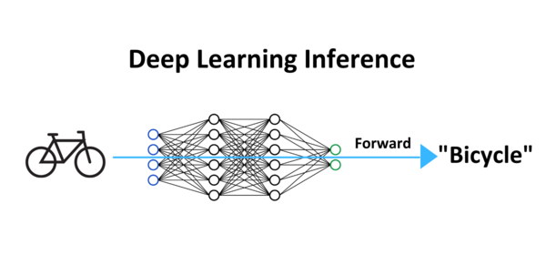

Slide 17


Slide 18
PyTorch for Deep learning
Library for python programs
Flexible
Excellent introduction to deep learning
Professional Context
Core data structure is tensor (multidimensional array)
Shares many similarities with NumPy arrays
Notes:
At its core, the deep learning machine in figure 1.1 is a rather complex mathematical function mapping inputs to an output.
PyTorch comes with features to perform accelerated mathematical operations on dedicated hardware, which makes it convenient to design neural network architectures and train them on individual machines or parallel computing

Slide 19
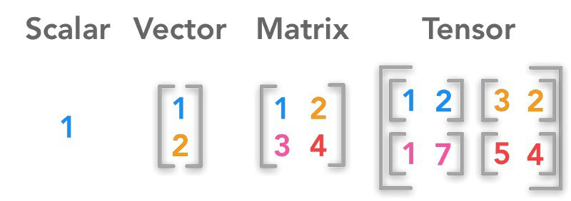

Slide 20

Why PyTorch?

Slide 21
Why PyTorch
PyTorch is easy to learn, use, extend, and debug
Programming the deep learning machine is very natural in PyTorch
Tensor, to hold numbers, vectors, matrices, or arrays
Accelerated computation using graphical processing units (GPUs)
Support numerical optimization on generic mathematical expressions,
PyTorch as a high-performance library with optimization support for scientific computing in Python
Notes:
PyTorch offers two things that make it particularly relevant for deep learning: first, it provides accelerated computation using graphical processing units (GPUs), often yielding speedups in the range of 50x over doing the same calculation on a CPU. Second, PyTorch provides facilities that support numerical optimization on generic mathematical expressions, which deep learning uses for training

Slide 22


Slide 23
How PyTorch supports deep learning Projects
PyTorch has the “Py” as in Python
A lot of non-Python code in it
For performance reasons, most of PyTorch is written in
C++ and CUDA
PyTorch is a library that provides
Multidimensional arrays, or tensors provided by torch module.
An extensive library of operations
Notes:
PyTorch has been equipped with a high-performance C++ runtime that can be used to deploy models for inference without relying on Python, and can be used for designing and training models in C++. It has also grown bindings to other languages and an interface for deploying to mobile devices.
CUDA (www.geforce.com/hardware/technology/cuda), a C++-like language from NVIDIA that can be compiled to run with massive parallelism on GPUs.

Slide 24
How PyTorch supports deep learning Projects
Moving computations from the CPU to the GPU
Provides the ability of tensors to keep track of the operation performed on them.
Tensors and the autograd-enabled tensor library
Physics, rendering, optimization, simulation, modeling, and more
Core PyTorch modules for building neural networks
torch.nn
Notes:
The main difference between CPU and GPU architecture is that a CPU is designed to handle a wide-range of tasks quickly (as measured by CPU clock speed), but are limited in the concurrency of tasks that can be running. A GPU is designed to quickly render high-resolution images and video concurrently.
PyTorch is a library that provides multidimensional arrays, or tensors in PyTorch parlance (we’ll go into details on those in chapter 3), and an extensive library of operations on them, provided by the torch module. Both tensors and the operations on them can be used on the CPU or the GPU. Moving computations from the CPU to the GPU in PyTorch doesn’t require more than an additional function call or two. The second core thing that PyTorch provides is the ability of tensors to keep track of the operations performed on them and to analytically compute derivatives of an output of a computation with respect to any of its inputs. This is used for numerical optimization, and it is provided natively by tensors by virtue of dispatching through PyTorch’s autograd engine under the hood.
Machine khud ko khudi evaluate krte hai aur khud he optimize krte hai.

Slide 25
Torch.nn
Common neural network layers
Other architectural components
Fully connected layers
Convolutional layers
Activation functions
Loss functions

Slide 26
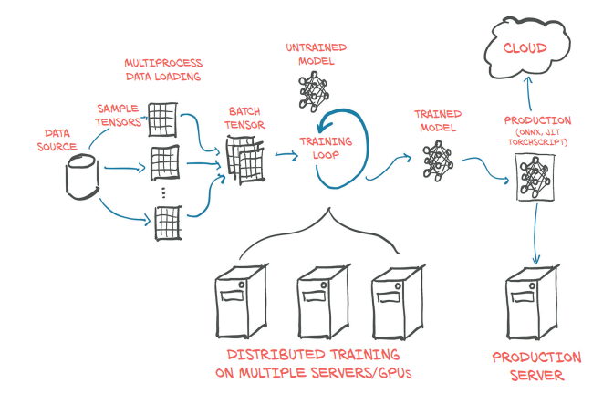
High Level Structure of PyTorch Project

Slide 27
Overview of how PyTorch supports deep learning
These components can be used to build and initialize the untrained model
In order to train our model, we need:
A source of training data
An optimizer to adapt the model to the training data
A way to get the model and data to the hardware that will actually be performing the calculations needed for training the model.

Slide 28
High Level Structure of PyTorch Project
PyTorch tensor is the Dataset class PyTorch provides in torch.utils.data.
Data storage is often slow, in particular due to access latency
PyTorch readily provides all that magic in the DataLoader class
At each step in the training loop, we evaluate our model
Compare the outputs
Using some criterion or loss function
Loss functions are provided in torch.nn
Notes:
. Just as it offers the components from which to build our model, PyTorch also has a variety of loss functions at our disposal. They, too, are provided in torch.nn. After we have compared our actual outputs to the ideal with the loss functions, we need to push the model a little to move its outputs to better resemble the target. As mentioned earlier, this is where the PyTorch autograd engine comes in; but we also need an optimizer doing the updates, and that is what PyTorch offers us in torch.optim.

Slide 29
High Level Structure of PyTorch Project
After we have compared our actual outputs to the ideal with the loss functions, we need to push the model a little to move its outputs to better resemble the target
autograd engine
optimizer does the updates
torch.optim

Slide 30
High Level Structure of PyTorch Project
Submodule can be employed to use the additional hardware.
torch.nn.parallel.DistributedDataParallel
torch.distributed
PyTorch defaults to an immediate execution model (eager mode)
Compile models ahead of time through TorchScript
Notes:
PyTorch also provides a way to compile models ahead of time through TorchScript. Using TorchScript, PyTorch can serialize a model into a set of instructions that can be invoked independently from Python:
(eager mode). Whenever an instruction involving PyTorch is executed by the Python interpreter, the corresponding operation is immediately carried out by the underlying C++ or CUDA implementation.

Slide 31
Hardware & Software Requirements
CUDA-capable GPU with 8 GB of RAM
Cloud computing providers
DAWNBench
Notes:
Moderately large networks can take hours to days to train from scratch on large, real-world datasets on workstations equipped with a good GPU. That time can be reduced by using multiple GPUs on the same machine, and even further on clusters of machines equipped with multiple GPUs. These setups are less prohibitive to access than it sounds, thanks to the offerings of cloud computing providers. DAWNBench (https://dawn.cs.stanford.edu/benchmark/index.html) is an interesting initiative from Stanford University aimed at providing benchmarks on training time and cloud computing costs related to common deep learning tasks on publicly available datasets.

Slide 32


Slide 33
Jupyter Notebooks
A Jupyter Notebook shows itself as a page in the browser through which we can run code interactively
The code is evaluated by a kernel, a process running on a server that is ready to receive code to execute and send back the results
By mixing source code, results of evaluations, and Markdown-formatted text cells, we can generate beautiful interactive documents.

Slide 34


